Slide 1

Chicago Crime Dataset Insights
Task
Conduct a complete data analytics study and from your analytics, advise the Chicago PD accordingly

Slide 2
Data Analyst
KABIR OLAWALE MOHAMMED
COHORT 13 – DATA ANALYTICS
PRESENTED TO ONE CAMPUS ACADEMY

Slide 3
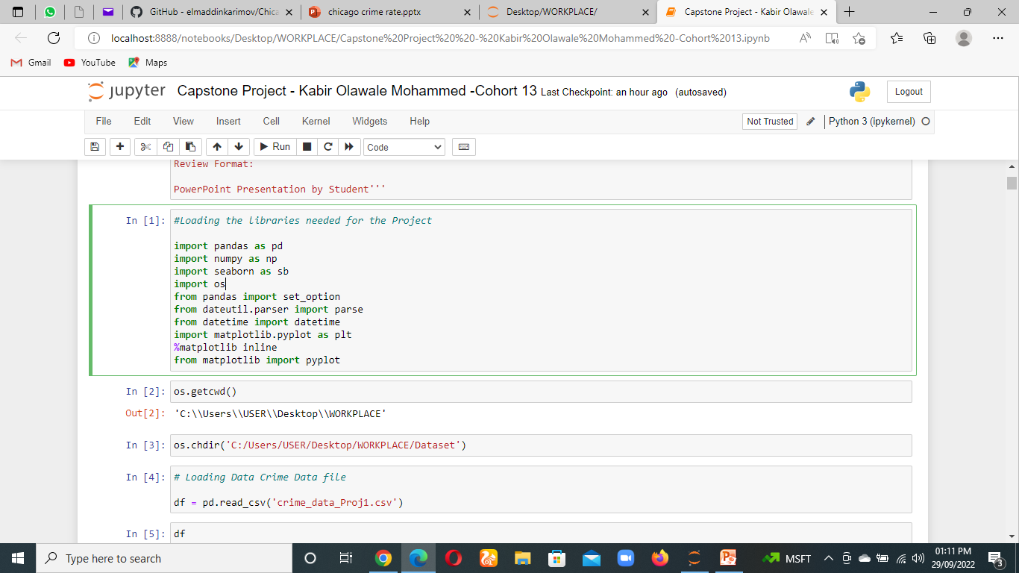
Import Packages
The above Packages for executing my analysis

Slide 4
Approach
Download and Upload the crime dataset from the given link
Analyze and clean data
Extracting the Day, Month and Period from the "Date" feature from the crime data
Extracting Year the Crime was updated on Police database and appending to the crime data
Extract the Day type from the Crime data
Extracting Length of time taken by Police to conclude investigation of the crime and appending to crime data
Find the most frequently committed crime
Find the most frequent Location for crime
Find the District that has the most crime viz the top crime and top location
Analyze impact of indicators on crime Level in Chicago

Slide 5
Data Cleaning Process
Check for Missing values
Check for Duplicates
Drop missing values and duplicates if present
Since Modeling is not part of the project the following will NOT be done:
1. Data Transformation
2. Checking for outliers
Select the Data features to be used for Visualization and insights
Plot chats to visualization and insights

Slide 6
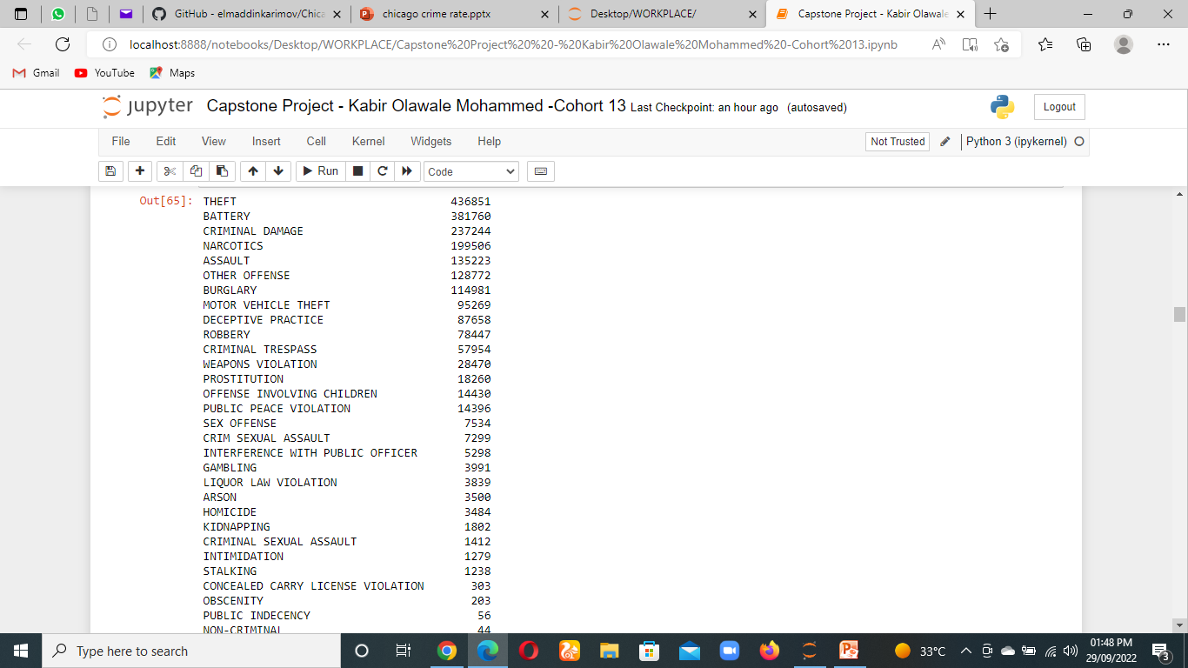
By using this syntax
We determined the most committed Crime
df['Primary Type'].value_counts()

Slide 7
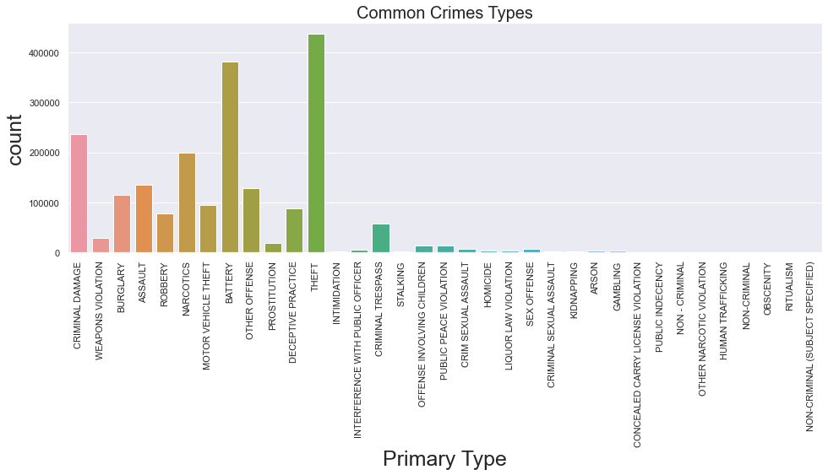
From the above:
The common crime in Chicago is Theft, Battery, Criminal Damage, Narcotics and Assault.
These kinds of crime are Associated with areas that there is affluence, which could suggest the income level of Chicago is high, Also This could suggest high income disparity and also presence of some type of gangs
I will examine the common locations and crime description to have better insights

Slide 8
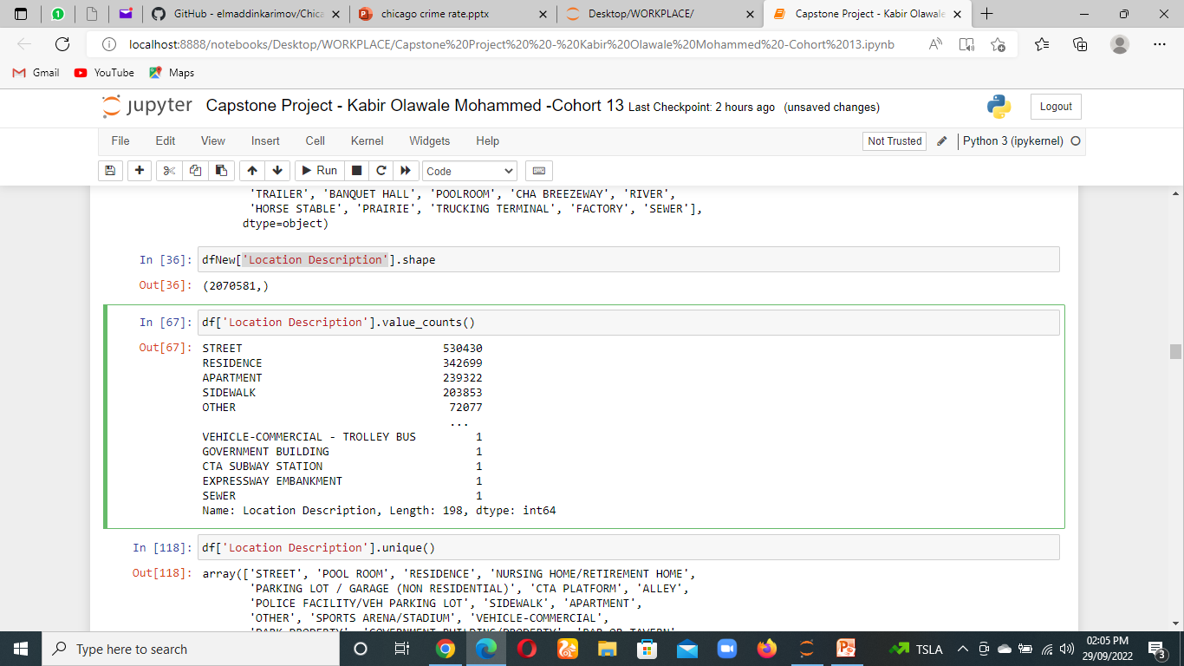
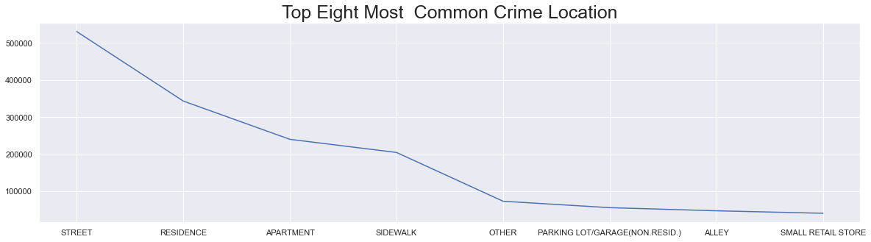
By using this syntax
We determined the most common Crime Location
df[‘Location Description'].value_counts()

Slide 9
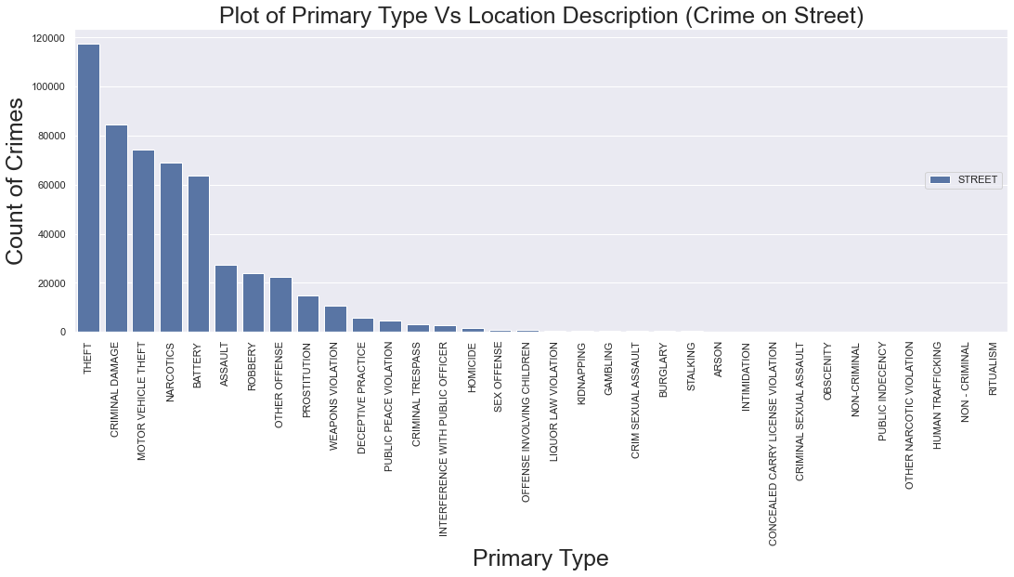
From the above:
The top Location for crime in Chicago are: Street, Residence, Apartment, and Sidewalk
The Major crimes that happen on the street are: Theft, Criminal Damage, Motor Vehicle Theft, and Narcotics
I will examine the type of crimes that happens in these common location of most of these crimes to have better insights

Slide 10
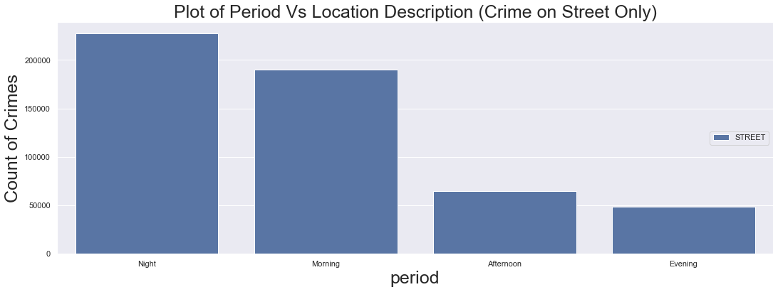

Slide 11
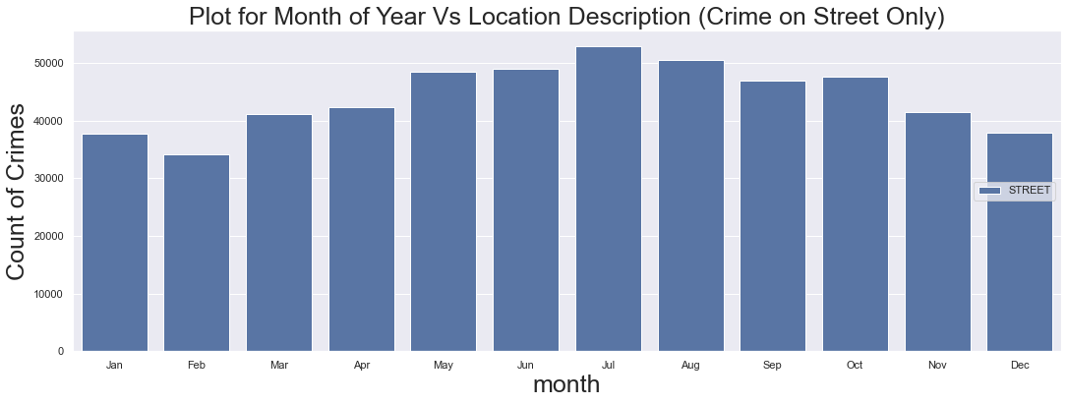

Slide 12
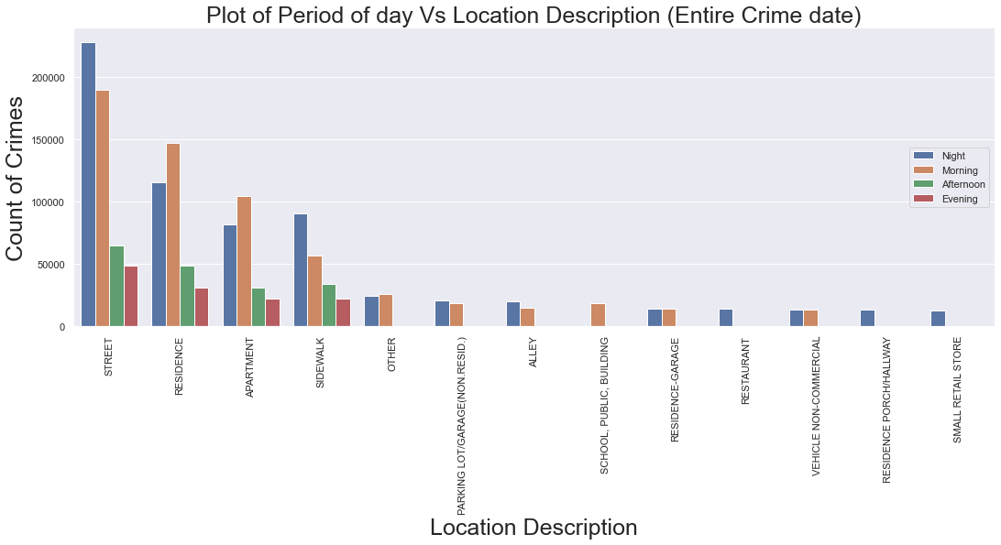
From the above:
A lot of crimes take place in the top locations mostly in the Night and Morning, which means the police need to step up patrol during in the mornings and at night.
Across all the top most location crimes is generally more at night which means that more lighting is required in location to reduce the prevalence of crimes

Slide 13
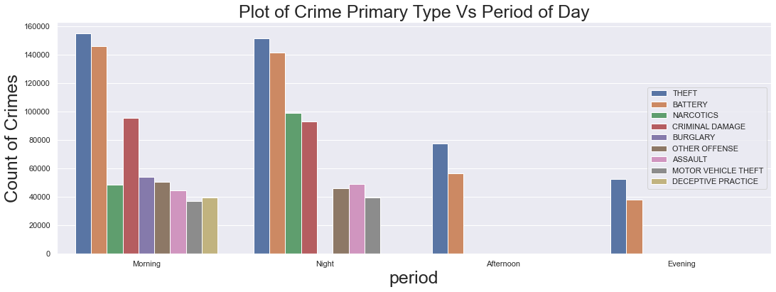
From the above most of the crimes happens in the morning and night
Worthy of note is that Burglary happens mostly in the morning, because most people are out of their residence during the period for work and other engagements
Battery and Theft crime is present all day
The chart also Which shows that a lot of crime activities takes place mostly in the morning and Night
Will examine the crime pattern across the weekdays

Slide 14
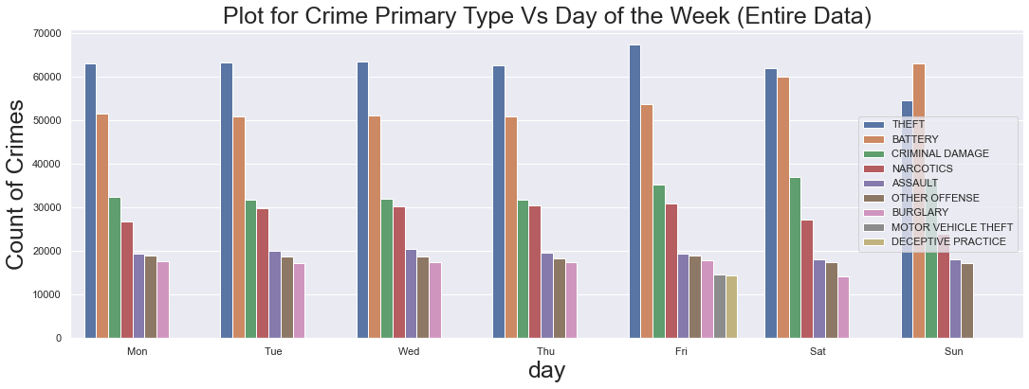
From the above there is no significant change in crimes on a weekday basis
But battery is higher on Sunday and Saturday due to that fact that it is the day family members and community share time together and engage more on a casual basis
Will examine crime data on a monthly basis and Day type and see

Slide 15
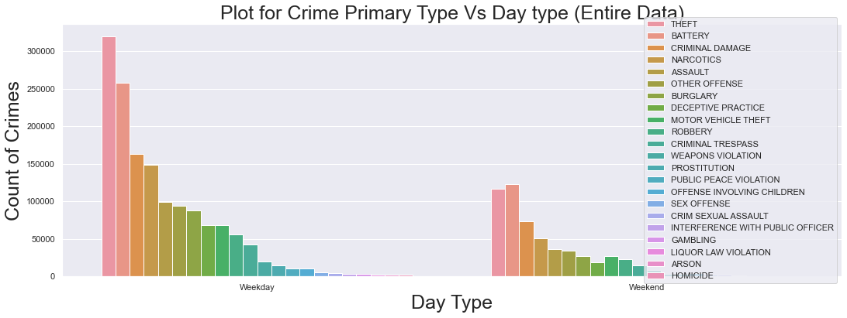
From the above there is more crimes during the weekdays than on weekends.
We examine the data on an monthly basis for better insight

Slide 16
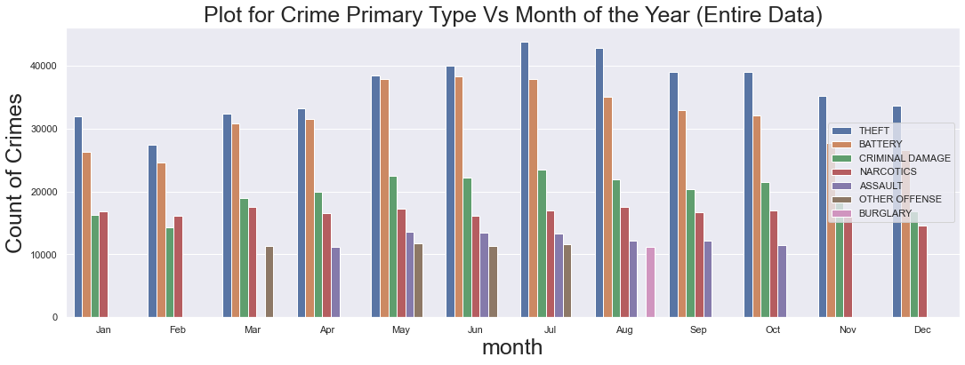
From the above crime peaks at around July and August which indicates that Chicago is an heavily into Agriculture and harvesting, or some kind of income generation activity as it coincide with the rain pattern in Chicago and is around that time of the year and a lot of money is in circulation, hence increase in crime.
Also battery also peaks at around July and August from a low in January, which correlate with my initiate assertion of money level being highest in July and August and goes down with as the year ends. less fighting among family members when there is plenty of money to go round
Will examine on a Yearly basis to get better insight

Slide 17
From the above:
A downward trend in crime rate year on year for Chicago is observed which suggest:
1. Increase in the quality of policing and increased policing activities
2. Notice the complete absence of some crimes type in Chicago as the years goes by
I will explore the level of arrests to determine if there is increase in the quality of policing

Slide 18
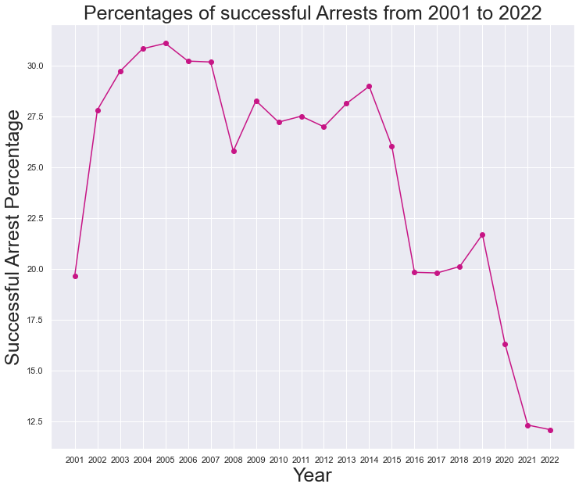
From the above, there is downward trend in arrest and non-arrest in criminal engagement with the police. This is in line with findings when plot of Crime type Vs Year was done
Plot of Crime Type Vs Arrests to get better insight

Slide 19
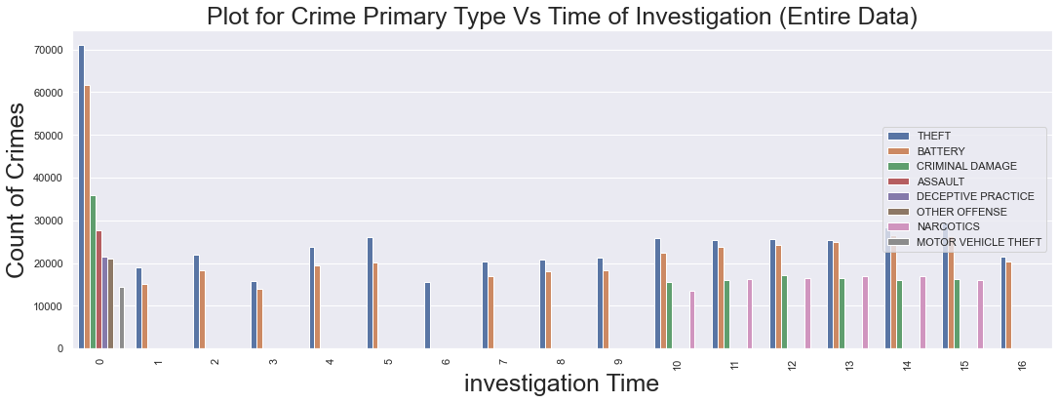
From the above you see that the most of the major crimes are solved within the year of being reported. This suggests there is adequate Police workforce.
A lot of cases of Theft and Battery linger for very long and up to 16 years. Crime of Theft and Battery require painstaking investigation which may be the reason some of the reported investigation go beyond one year to resolve. Assault crimes are mostly solved within the year of arrest.
Narcotics cases take the longest time to solve due to delicate and meticulous nature of the investigations involved
Will examine crimes across districts for more insights

Slide 20
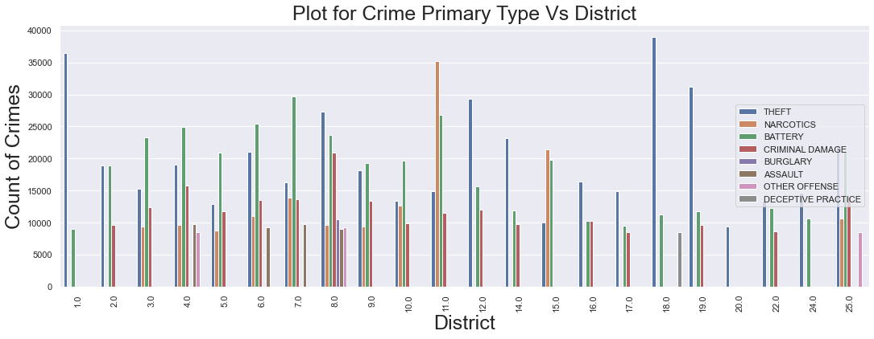
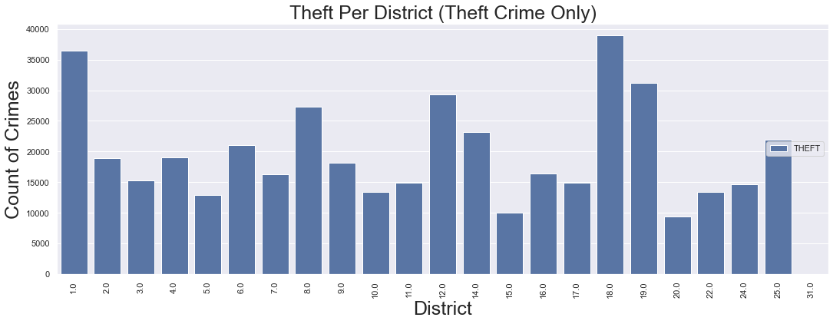

Slide 21
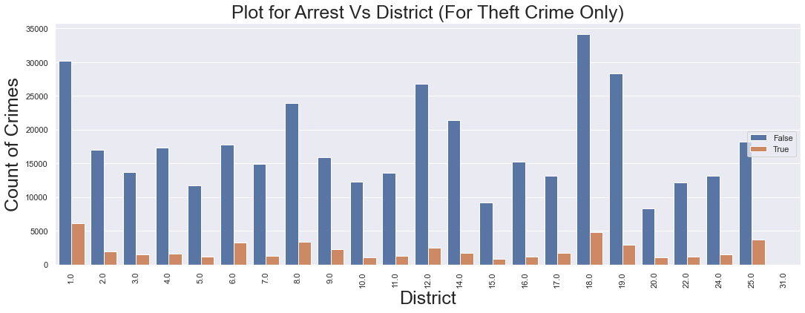
District "3 - 11" and "25" has as lot of crime types and the predominant crimes are Theft, Battery and Narcotics
which may suggest:
Presence of a lot of gangs and gang related crimes
2. Police will be very busy in this Districts considering the level of crime
3. Theft is the highest in District 1.0, 18.0 and 19.0

Slide 22
Conclusion and Advice for the Police of Chicago
There has to be increased police presence on foot patrol during the Nights and Morning especially on the streets, residential Area to prevent crimes of theft and assault
The Chicago City has to provide more elimination for the streets to prevent crimes especially at night as a largest portion of crimes in Chicago happens at night and on the streets.

Slide 23
Continue…..
There needs to be increased Police presence on the street of Chicago from around May till July as crimes on the streets peaks at around that period of the year.
Particular focus should be given to District 1 and 18 as there is high incidents of theft in these Districts.
Others to focus on are district 8, 12, 14 and 19. This is because Theft accounts for a sizable portion of crimes in Chicago City

Slide 24
Continue…
More Detectives have to drafted into investigation of Theft and it takes sometimes up to 16years to conclude investigations on theft although a sizable portion of theft investigation is conclude within the first year of being reported.

Slide 25
Thank You!
Q & A

